Slide 1


Efficient Learning
on Point Clouds
with Basis Point Sets
Sergey Prokudin*¹, Christoph Lassner⁺², Javier Romero⁺³
¹Max Planck Institute For Intelligent Systems, Tübingen; ² Amazon, Tübingen; ³Amazon, Barcelona
* work done during internship at Amazon
+ equal contribution
Notes:
Hi, I'm Sergey. Today I would like to talk about how we can simplify, both conceptually and computationally, machine learning on point clouds. This is the work I've done together with Christoph and Javier during my internship at BodyLabs, which is now a part of Amazon.

Slide 2
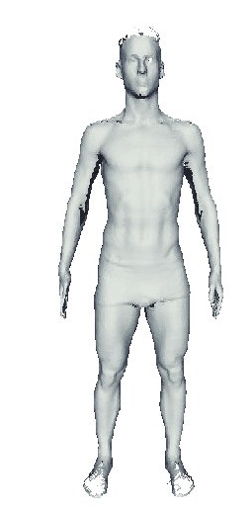
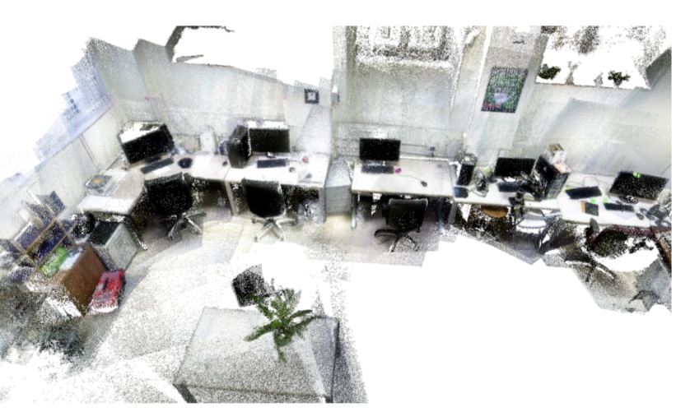
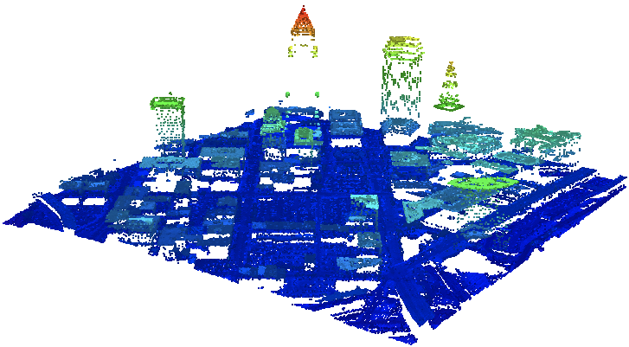
Learning on Point Clouds
Point clouds: a set of 3D points. Point cloud data is ubiquitous nowadays, with sources including photogrammetry software, LIDARs and RGB-d cameras:
Problem: learning algorithms typically expect a vector of fixed length, with every position describing a particular feature. Point clouds have a varying length and lack any semantic ordering.
Notes:
First, what is point cloud? It is simply a collection of 3D points. This type of data is widespread nowadays, with sources including photogrammetry software, LIDARs and RGB-d cameras.
However, it is not a particularly convenient type of input for learning algorithms. Machine learning algorithms typically expect a vector of fixed length, with every position describing a particular feature, while point clouds have a varying length and lack any semantic ordering.

Slide 3
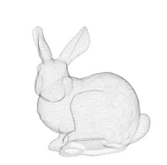
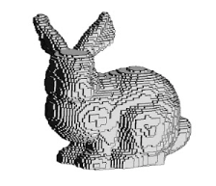
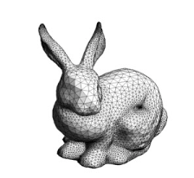
Existing solutions
Working with point clouds directly: special architectures (PointNet, DeepSets) are needed to handle variable length and order invariance, leading to an increased computational complexity;
Occupancy grid, TSDF: regularly leads to cubicle growth of parameters needed to represent a surface;
Mesh: registration is an ill-posed and computationally-intensive optimisation process.
Research question: can we come up with a representation of point clouds that can be easily computed and efficiently used for learning?
Notes:
There are of course, a number of existing solutions to the problem.
We can decide to work with point cloud input as is. In that case special network architectures (e.g. PointNet or DeepSets) would be needed that handle variable length and order invariance. This typically leads to an increased computational complexity.
Another option is voxelization with occupancy grids or truncated signed distance fields. This typically leads to a cubicle growth of parameters needed to accurately represent a surface.
Finally, we can think of a mesh representation. However, aligning mesh on a given cloud is computationally intensive optimisation process on its own.
Hence, we a phrased the following research question: can we come up with a representation of point clouds that can be easily computed and efficiently used for learning?

Slide 4
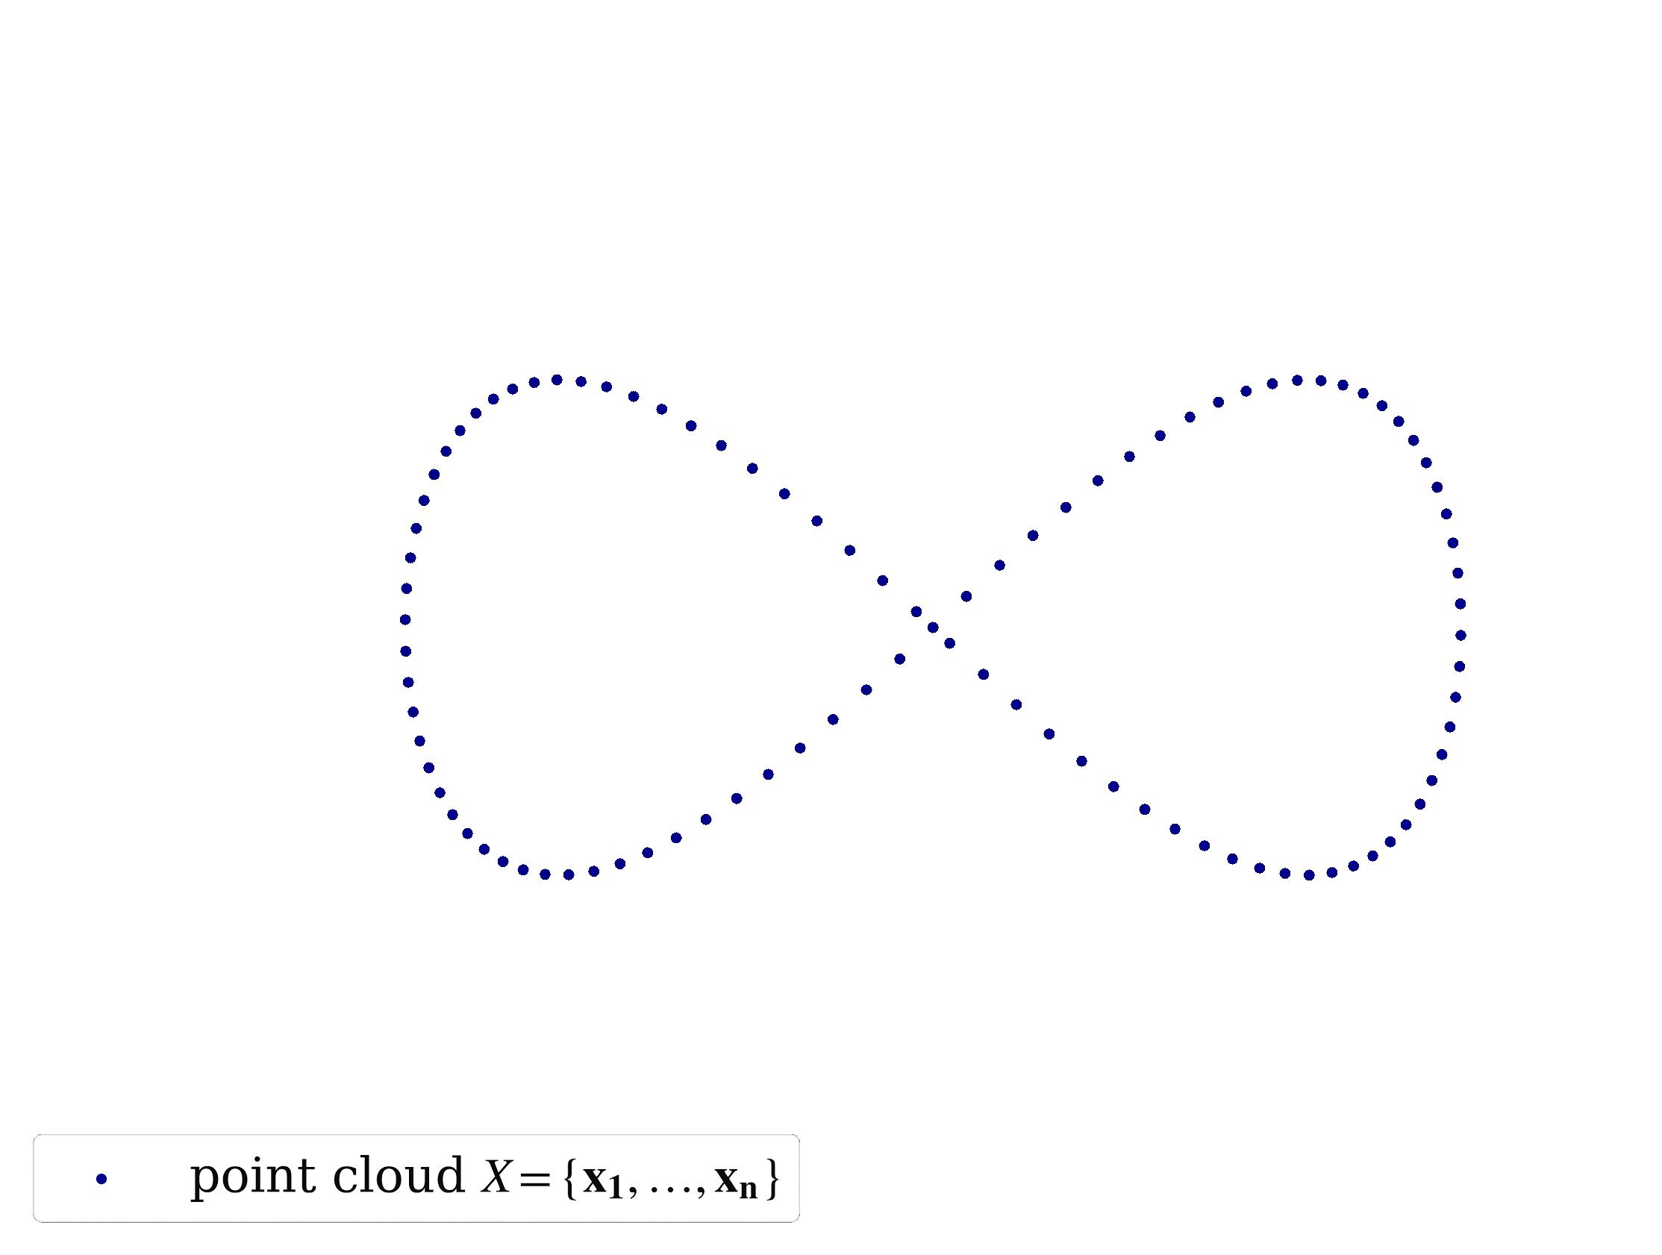
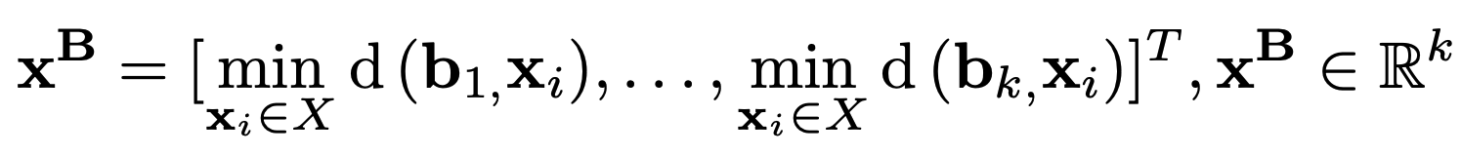
Basis Point Set
Simple idea: select k fixed points in space and compute vectors from these basis points to the nearest points in the point cloud. Use these vectors (or simply their norms) as features:
Important: these k points are the same for all the point clouds in the dataset, providing a fixed representation of every point cloud as a vector.
Other features: storing full directional information, RGB values of nearest points.
Notes:
The idea behind our approach is fairly simple. We select k fixed points in space and compute vectors describing the direction from these basis points to the nearest points in the point cloud. Use these vectors (or simply their norms) as features.
It's important to note that these k points in space are the same for all the point clouds in the dataset, providing a fixed representation of every point cloud as a vector.
We can also use the full delta vectors to the closest points or any other information available about the nearest point, for example its RGB value.

Slide 5
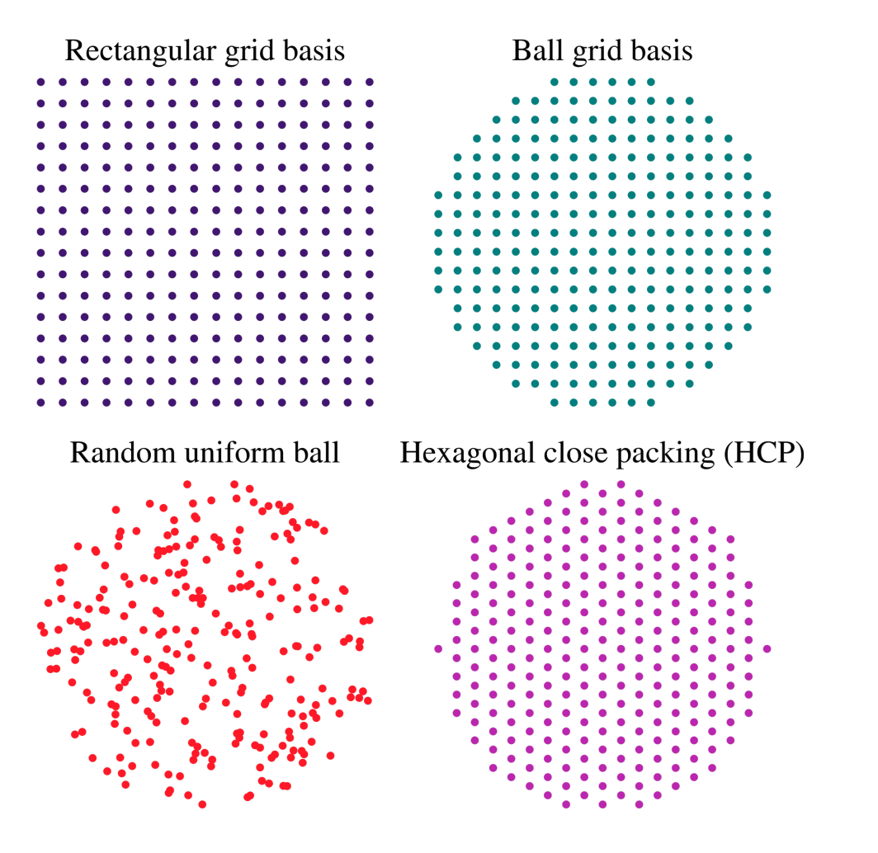
BPS Selection Strategies
We can experiment with basis point arrangements:
Different selection strategies allow applications of different types of convolutions.
Notes:
We can experiment with basis point arrangements. Different selection strategies allow applications of different types of convolutions.

Slide 6
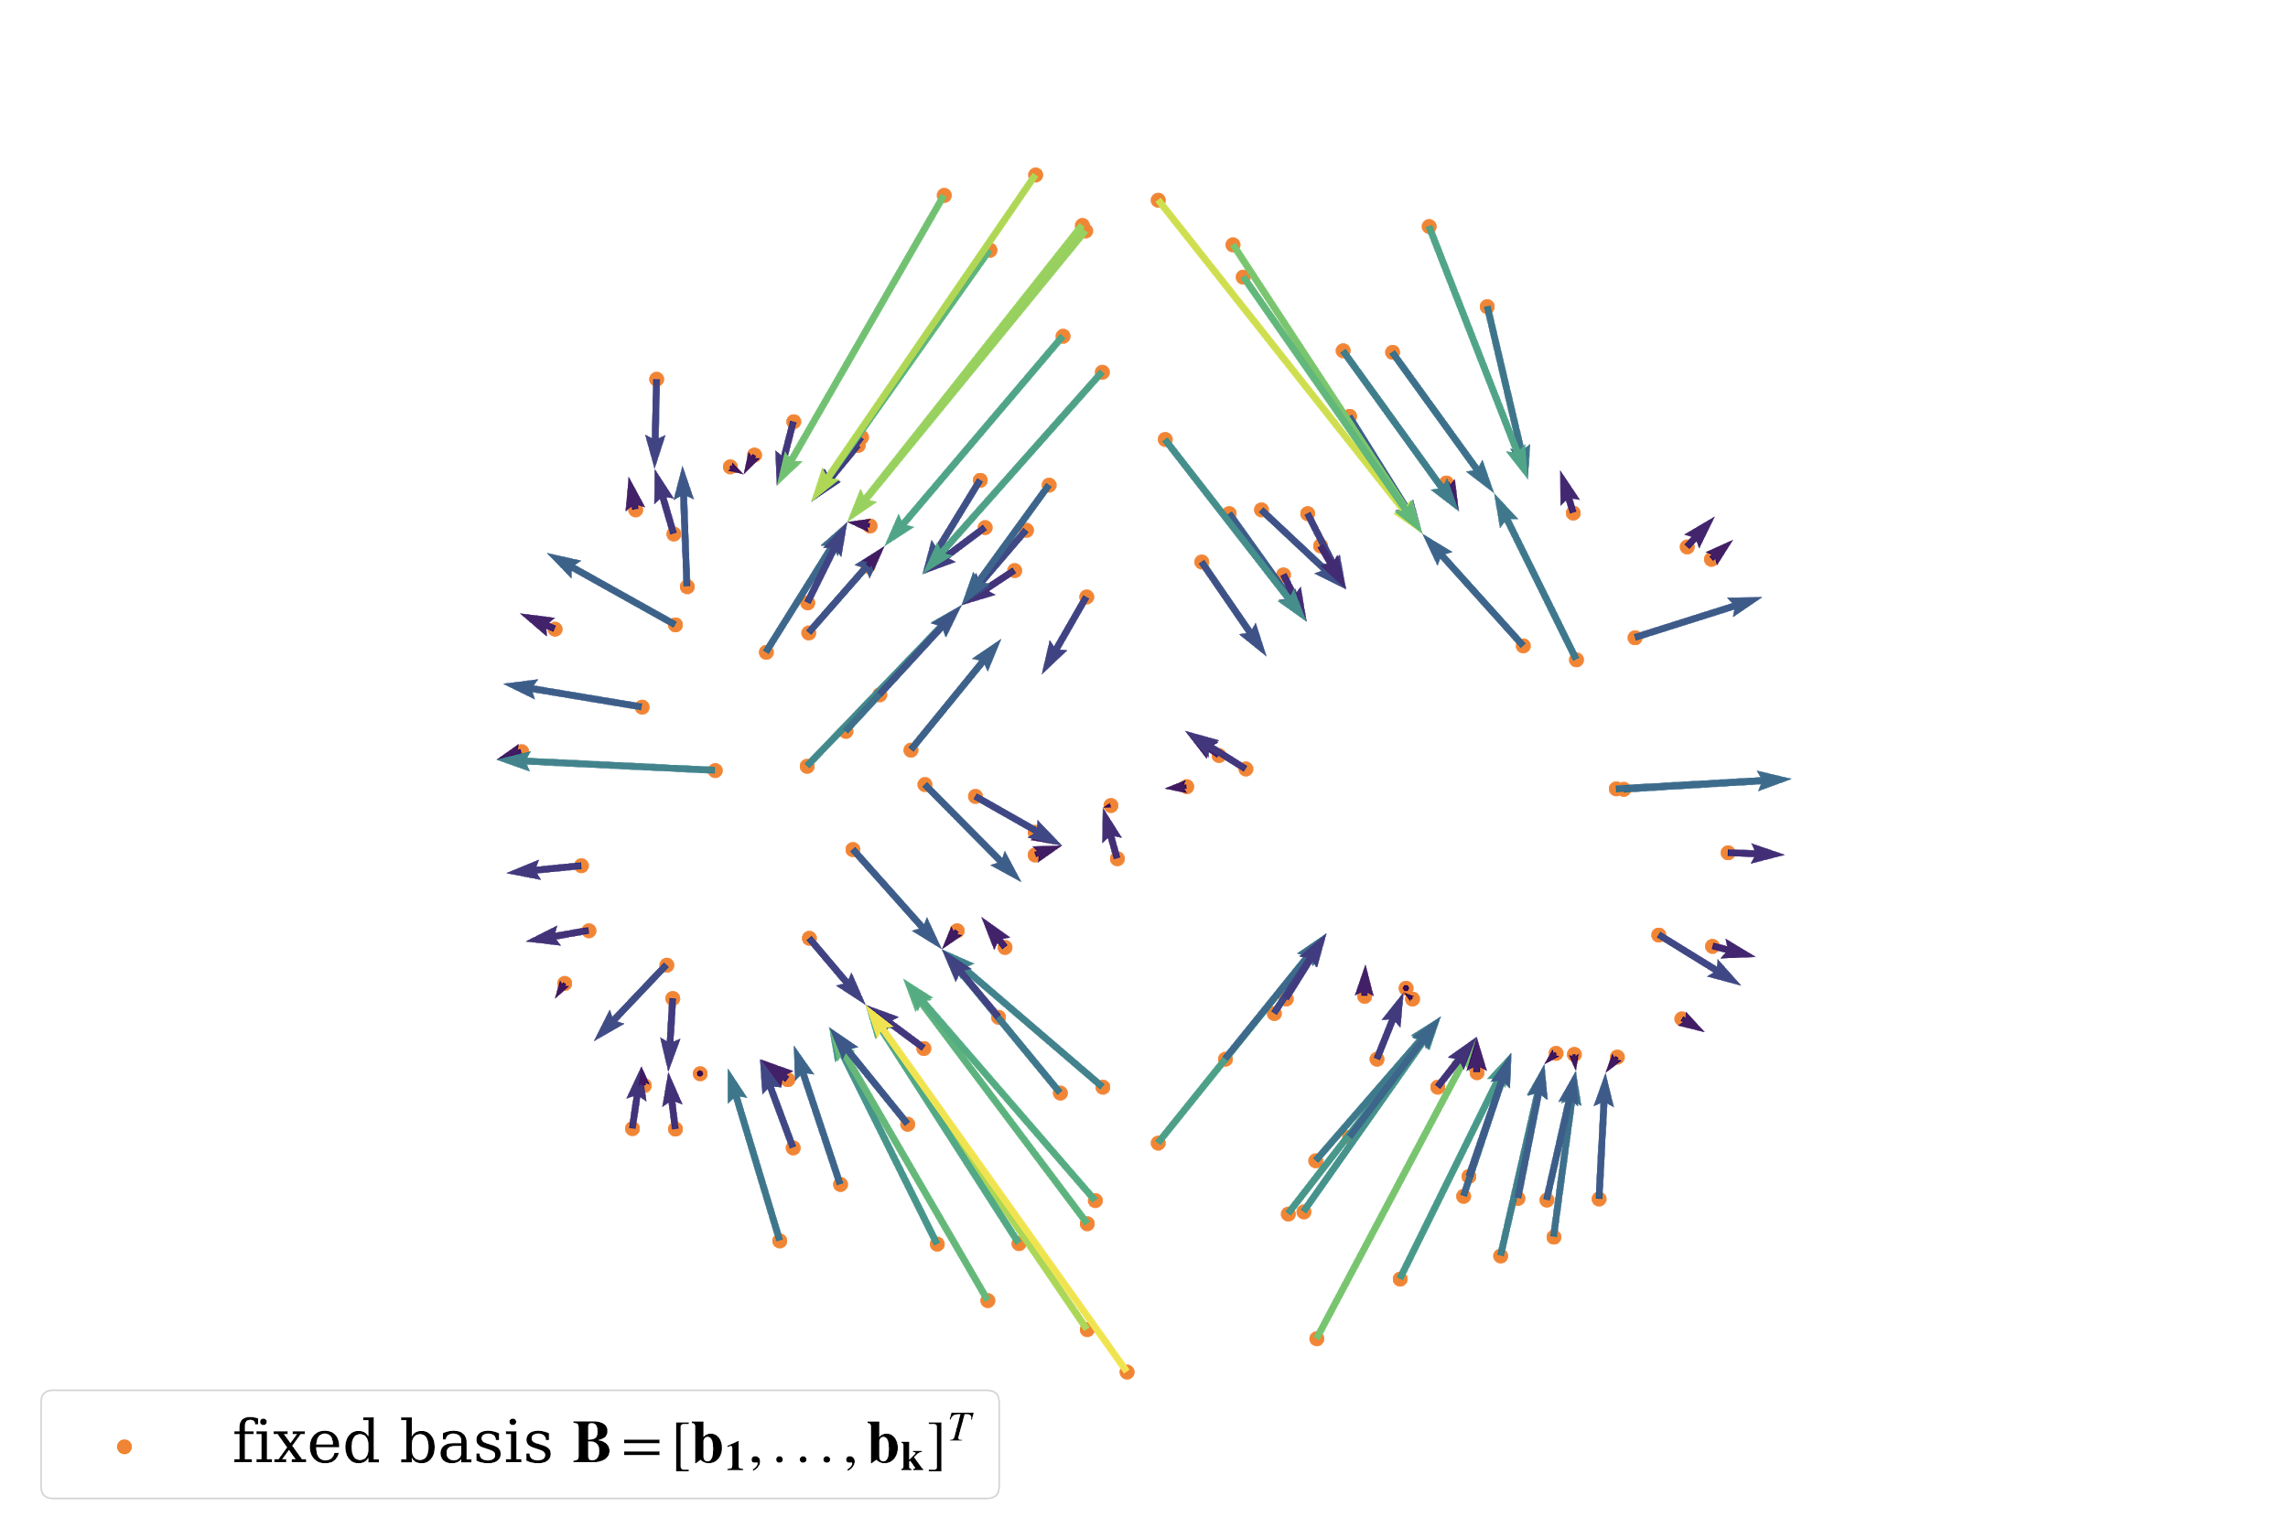
Encoding Analysis
Lossy point encoding: by storing full delta vectors to the nearest points we can reconstruct some subset of the original cloud:
Notes:
We would like to note that when full directional vectors to the nearest points are used, BPS constitutes lossy encoding since we can reconstruct some subset of the original cloud by adding those vectors to basis point locations..

Slide 7
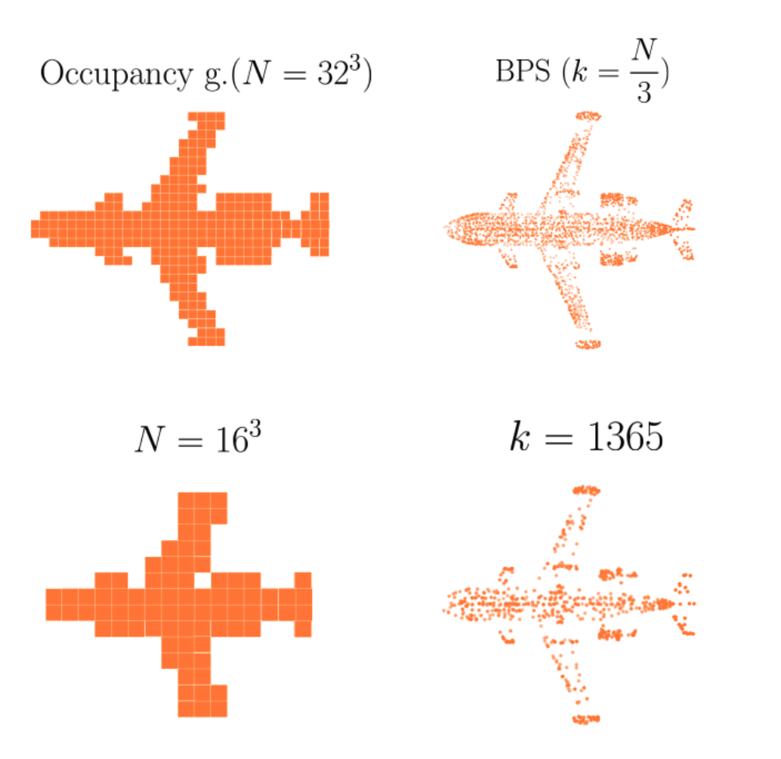
Encoding Analysis
Question: independent of a certain point cloud and learning task at hand, how well does the encoding capture the details of an object?
Experiment: encode 1000 objects from the Shapenet dataset with occupancy grids and BPS, with the same length N of a code.
Notes:
We can thus analyse how well does the encoding capture the details of an object, independent of a certain point cloud and learning task at hand.
We compare the quality of the reconstructed surface with the one obtained with another classic fixed length 3D representation: binary voxel grids.
Qualitative results of this comparison are shown below. We can see that with the same length of encoding, BPS representation captures the details of the surface much better. Even when the number of basis points is small, the essential shape is nicely captured.

Slide 8
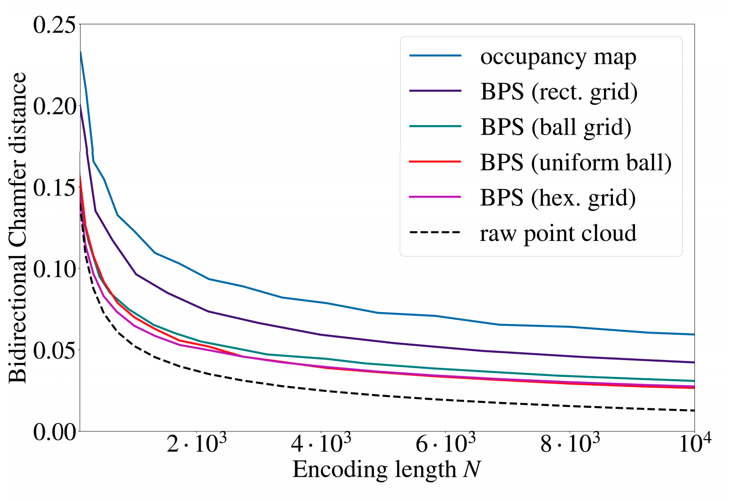
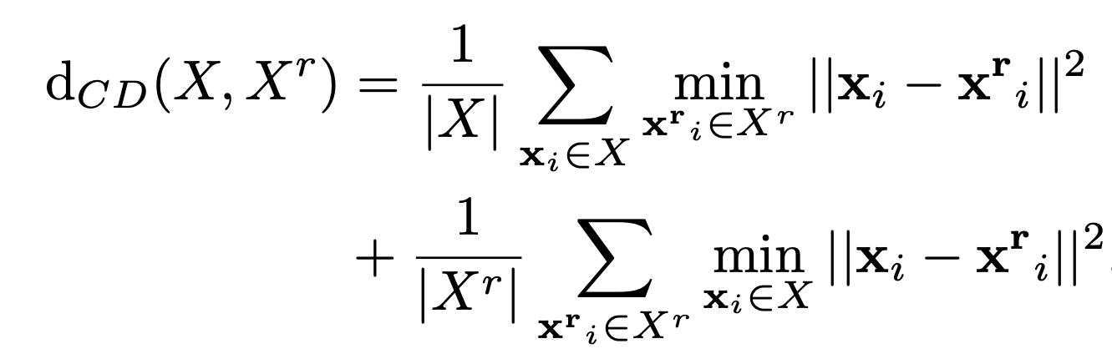
Encoding Analysis: Quantitative Comparison
Compare the Chamfer distance between encoded points and full cloud:
With the same length of encoding, BPS captures surface properties better than occupancy grids.
Notes:
We also provide quantitative comparison of the encoding by measuring the Chamfer distance between the original point cloud and its reconstructions with BPS delta vectors and occupied voxel centers.
Plot on the right shows how the distance between original and reconstructed surface decreases as we increase the length of encoding. For BPS, we show 4 different selection strategies, and we can see that the random sampling from a unit ball and hexagonal close packing of the BPS points provide the best results. These encodings are close in performance to the encoding with samples from the original point cloud, while being a fixed length vectors.

Slide 9
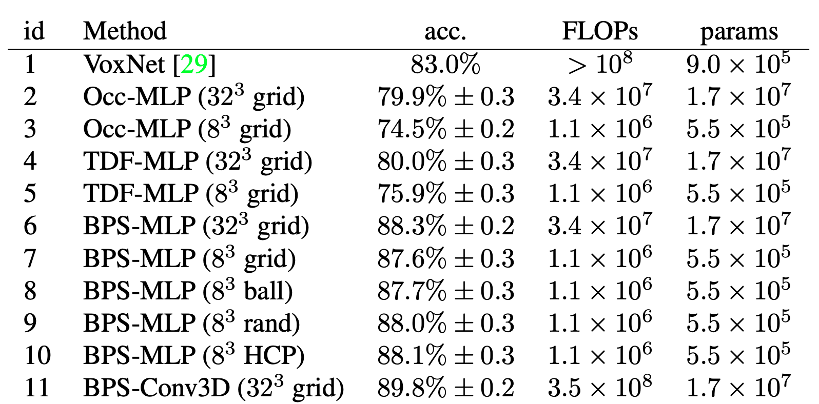
Learning with BPS: ModelNet40 Classification
Task: given a point cloud, predict its category (40 classes in total).
Comparison to occupancy voxels: fixed architectures (MLP, Conv3D-VoxNet), different 3D input (occupancy grid, TSDF, BPS):
Result: +7-8% accuracy compared to occupancy grids and truncated signed distance fields with the same network architecture.
Why? Intuition: compared to standard occupancy voxels that suffer from a massive sparsity, every BPS cell stores some global information about the surface, and feature vector changes smoothly when rotations or translations are applied to an object.
Notes:
We also compare our encoding to voxels and truncated signed distance fields in terms of learning capabilities. To this end, we fix two neural network architectures: simple two layer perceptron and VoxNet-like 3D convolutional neural network.
We can see that in both cases by simply switching to the BPS representation we are able to significantly improve the accuracy of our network.
The intuition behind this improvement is that while the standard occupancy voxels suffer from a massive sparsity, every BPS cell stores some global information about the surface, and corresponding feature vector changes smoothly when rotations or translations are applied to an object.

Slide 10
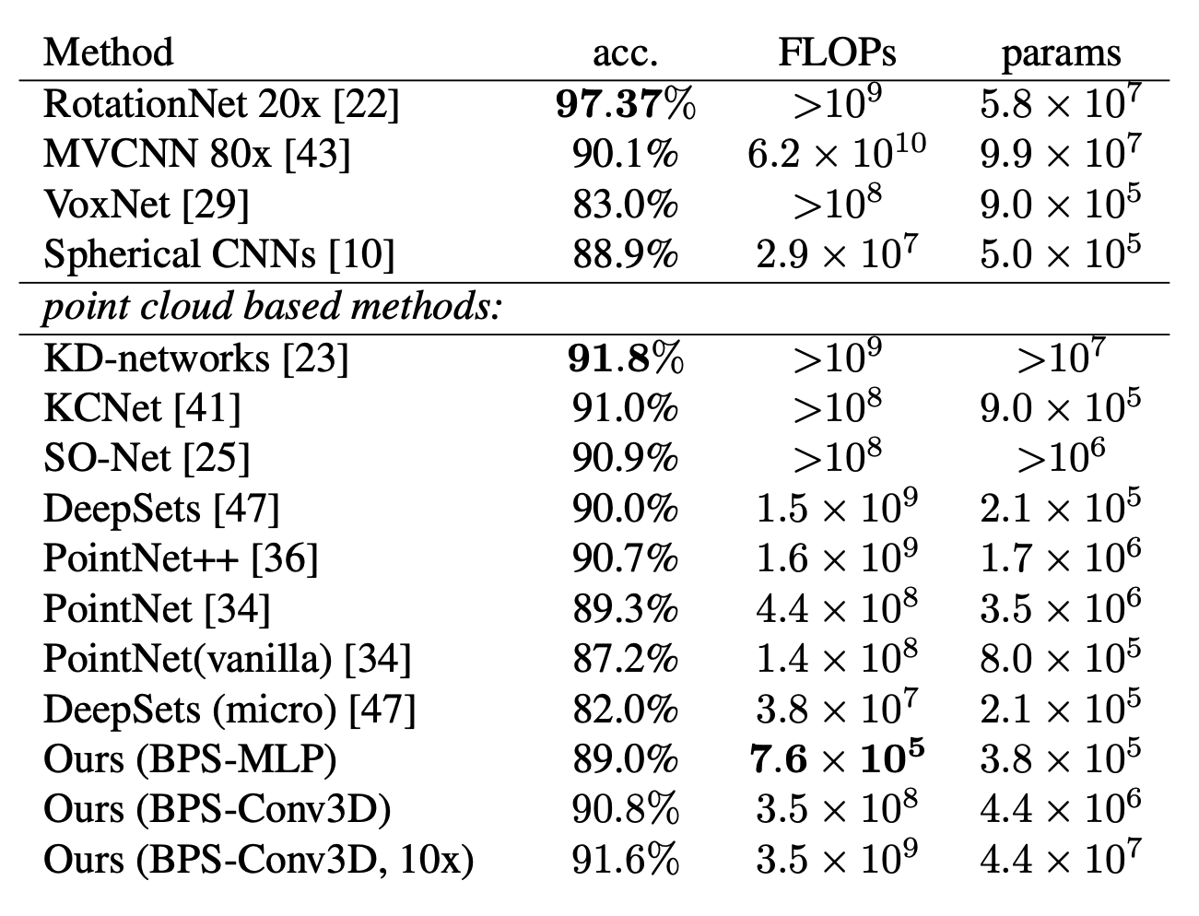
Learning with BPS: ModelNet40 Classification
Comparison to state-of-the-art. BPS allows to construct computationally more efficient and simpler architectures:
1. PointNet-like accuracy in 10 minutes of training with no GPU: simple multi-layer perceptron trained on BPS features as input can reach PointNet performance with 3 orders of magnitude less floating point operations.
2. Better 3D-convolutional networks: reaching PointNet++ performance with Conv3D-network on a BPS grid (still an order of magnitude less FLOPs).
Crude averaging of the models gives further improvements.
Notes:
We also compare fine-tuned versions of these networks trained on BPS features to various state-of-the-art point cloud based networks.
We can show that BPS allows to construct computationally more efficient and conceptually simple architectures.
In particular, we were able to approximately reach PointNet performance with a simple MLP and 3 orders of magnitude less floating point operations. This model can be actually trained in 10 minutes on a laptop with no GPU.
3D-convolutional model operating on a rectangular grid of BPS cells storing directional vectors is able to match PointNet++ performance, still with an order of magnitude less floating point operations needed.
We can further improve the results by simple crude averaging of these models.

Slide 11
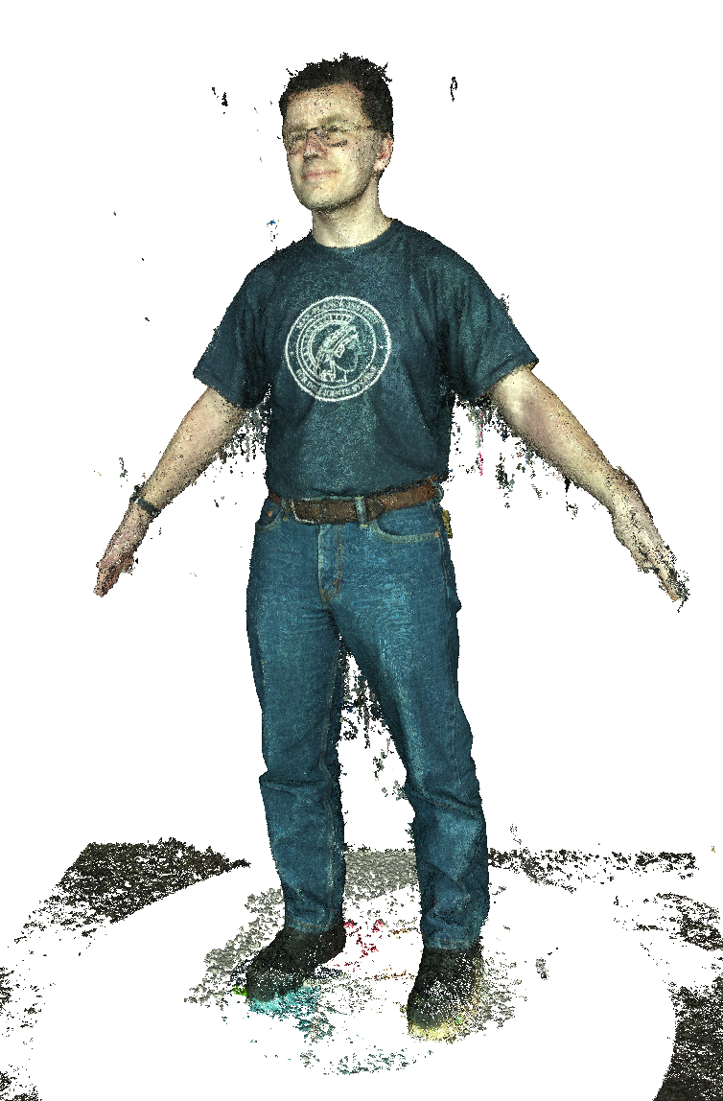
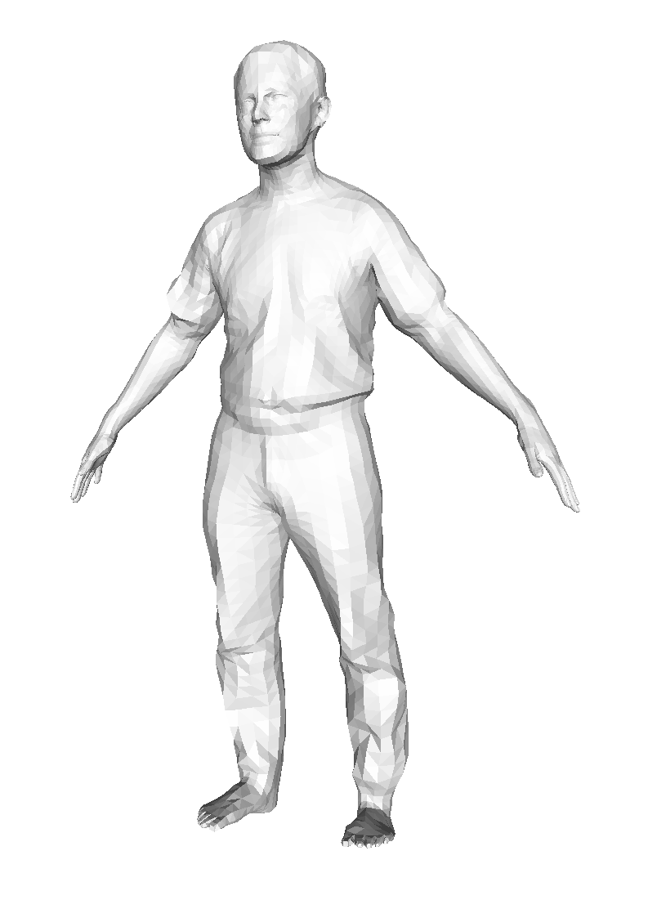
Learning with BPS: Mesh Registration
Task: given a point cloud, align 3D mesh on top of it.
Per-scan optimization process that can take from several minutes to several hours.
Notes:
We will now switch to the more challenging problem of mesh registration.
Here, the task is to align a deformable body template with a noisy point cloud obtained from a 3D scanner.
Regularly, this process requires per-scan optimisation taking from several minutes to several hours.

Slide 12
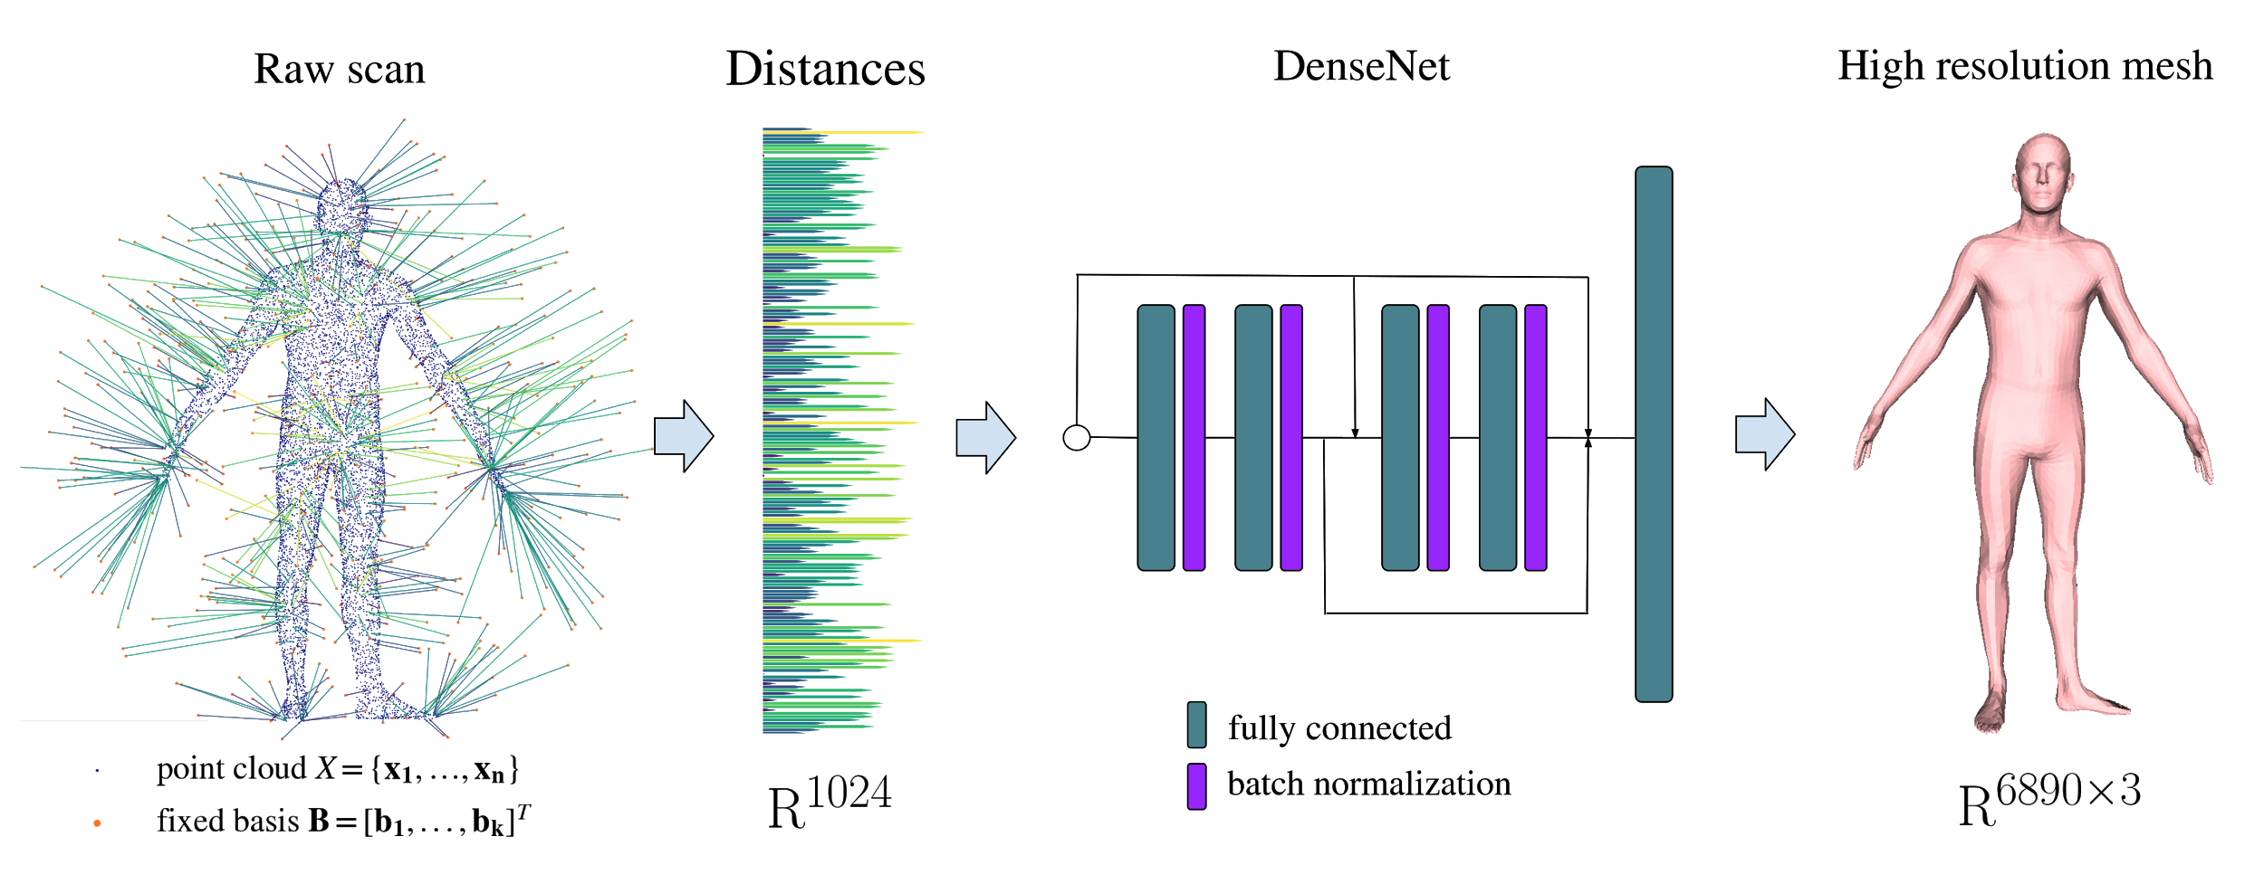
Learning with BPS: Mesh Registration
Our approach: cast the problem as a regression task, predict vertex locations directly by processing the BPS encoding of the cloud:
Inference takes less than 1ms.
Notes:
Instead, we cast this problem as a regression task and predict vertex locations directly by processing the BPS encoding of a 3D scan.
In this case, inference process takes less than 1 ms.

Slide 13
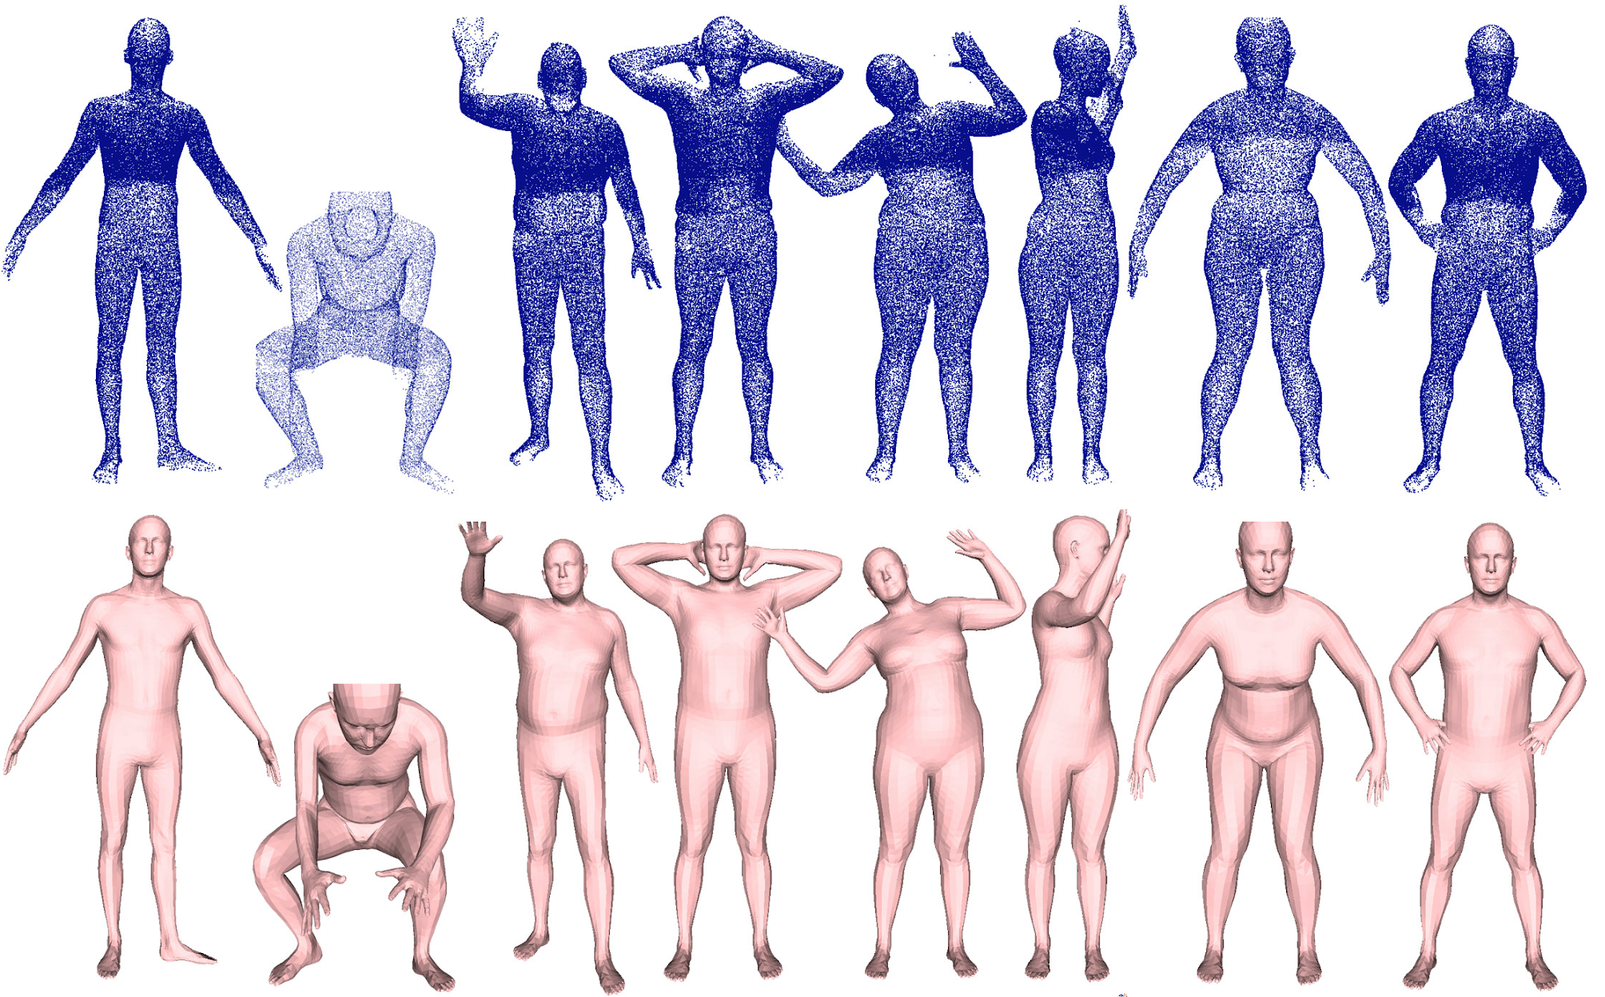
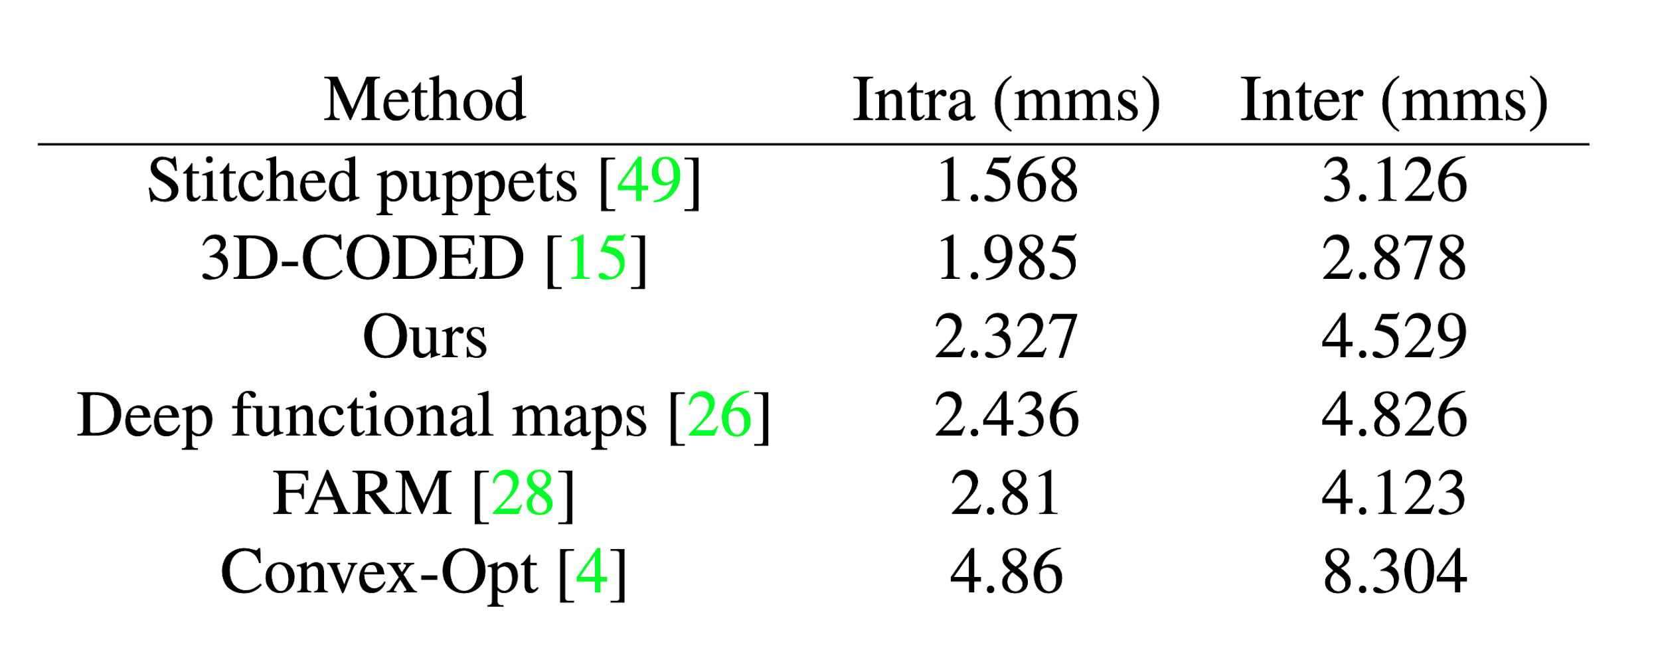
Learning with BPS: Mesh Registration
Training: 1M synthetic point clouds obtained from a posed deformable body model (SMPL).
Test: real scans (FAUST dataset).
input
predictions
Quantitative results: our method is comparable to state-of-the-art methods, while allowing real-time mesh registration.
Notes:
We train our network on 1 million synthetic point clouds obtained from a posed deformable body model, and test on the real human scans from the FAUST dataset.
Blue points show the input scans and skin-colored meshes show the alignments predicted by the method.
Quantitatively, our method is comparable to state-of-the-art methods, while allowing real-time mesh registration.

Slide 14
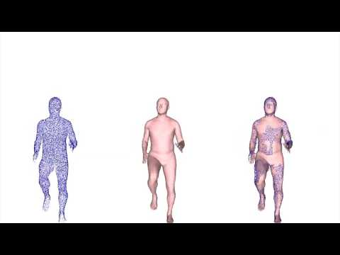
Results on dynamic real scans (DYNA dataset)
https://www.youtube.com/watch?v=kc9wRoI5JbY
Notes:
We also show the results of our method on the 4D sequences of scans from the DYNA dataset.
Note that these are the results of a pure per-frame application of the network, no temporal smoothing or any other postprocessing were applied to the network output.
Overall, we obtain temporally smooth sequences, with the main artefacts being caused by a large floor and wall noise not modeled in the training data.

Slide 15
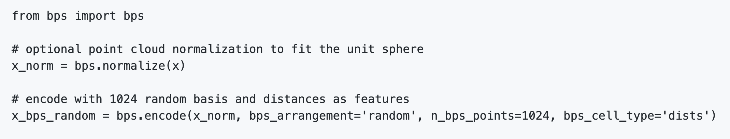

Summary
conceptually simple and computationally efficient method for point cloud encoding;
allows to use various machine learning techniques and network architectures out-of-the-box;
code will be released soon, conversion to BPS takes few lines:
https://github.com/sergeyprokudin/bps
Notes:
To summarise, we present conceptually simple and computationally efficient method for point cloud encoding.
It allows to use various machine learning techniques and network architectures out-of-the-box;
We will release the code, with which conversion to BPS takes just a few lines.

Slide 16



Thank you!
Sergey Prokudin
Max Planck Institute
for Intelligent Systems
Christoph Lassner
Amazon Tuebingen
(now @Facebook Reality Labs)
Javier Romero
Amazon Barcelona

